Slide 1

ManitobaWildFire Prediction
Good guys
MENTOR : Qiang Zhang
LEADER: Luwei Lin
MEMBER: Haozhi Wang Luxiang Lin

Slide 2

WILD-FIRE PERDICT
Previous understanding of machine learning.
Project Progress
what we learned and Our expectation.

Slide 3
Previous Understanding of ML.
Data Collection from Various Source
Data Cleaning and Feature Engineering
Model Building

Slide 4
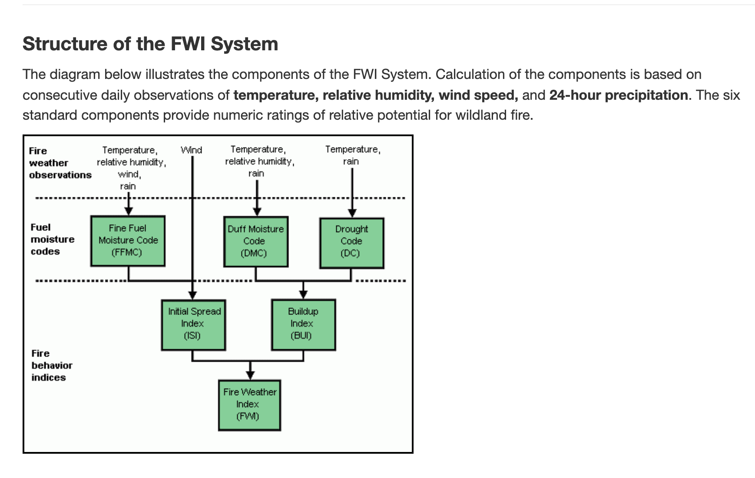

Slide 5
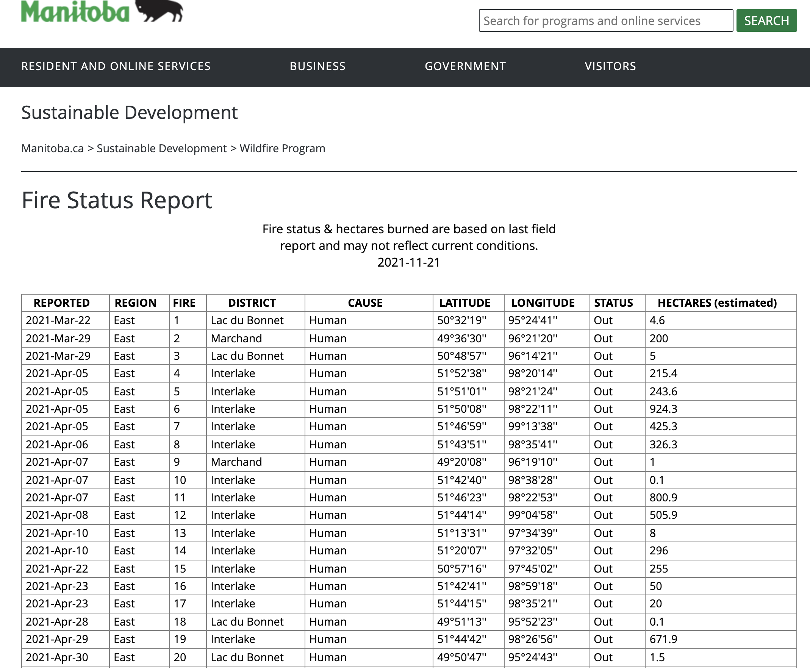
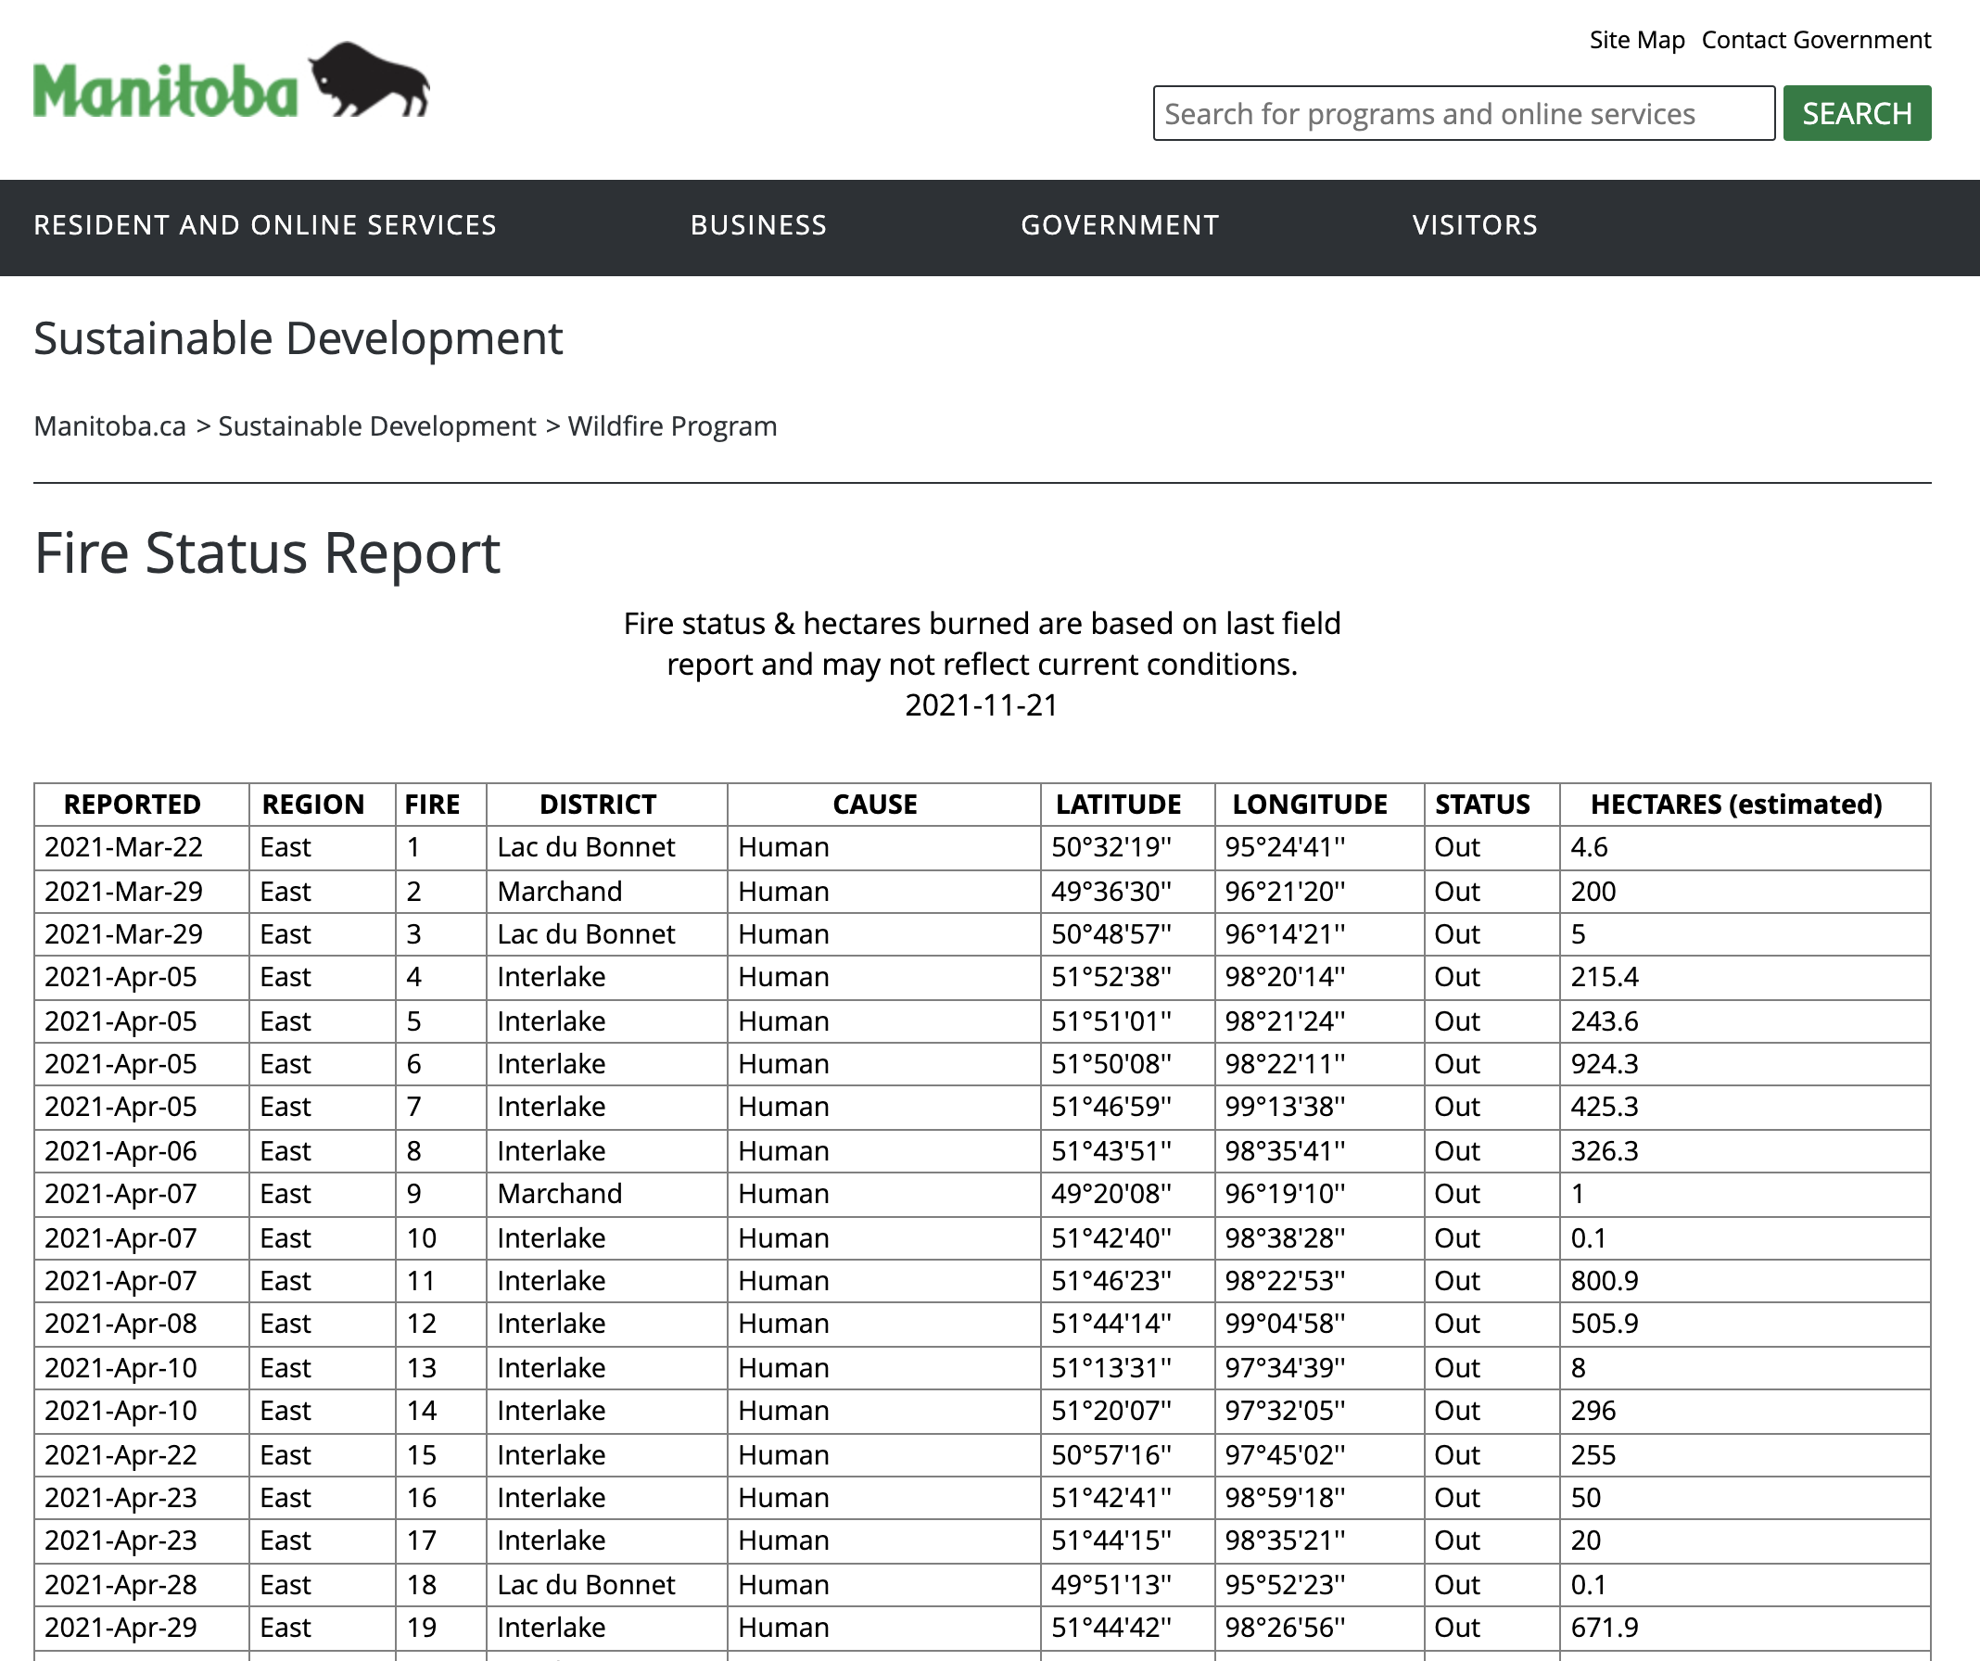

Slide 6
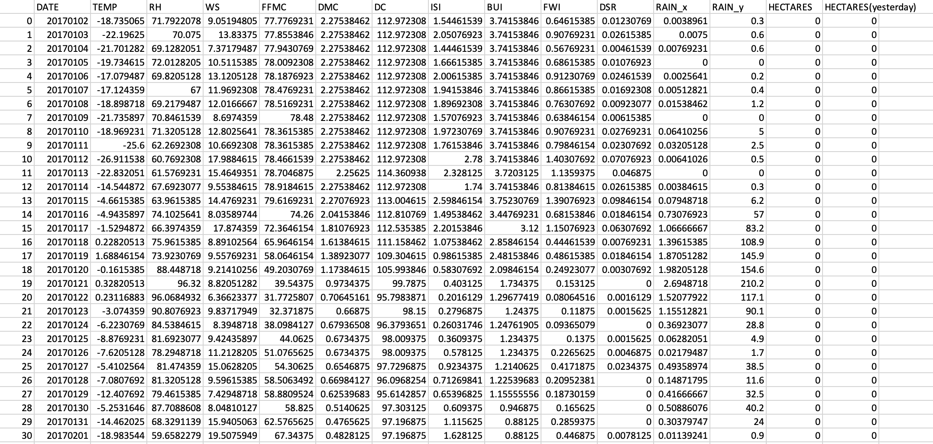

Slide 7
Project Progress
Find a way to model this proposal
Determination of variables in the previous assumptions
Choose the right model.

Slide 8
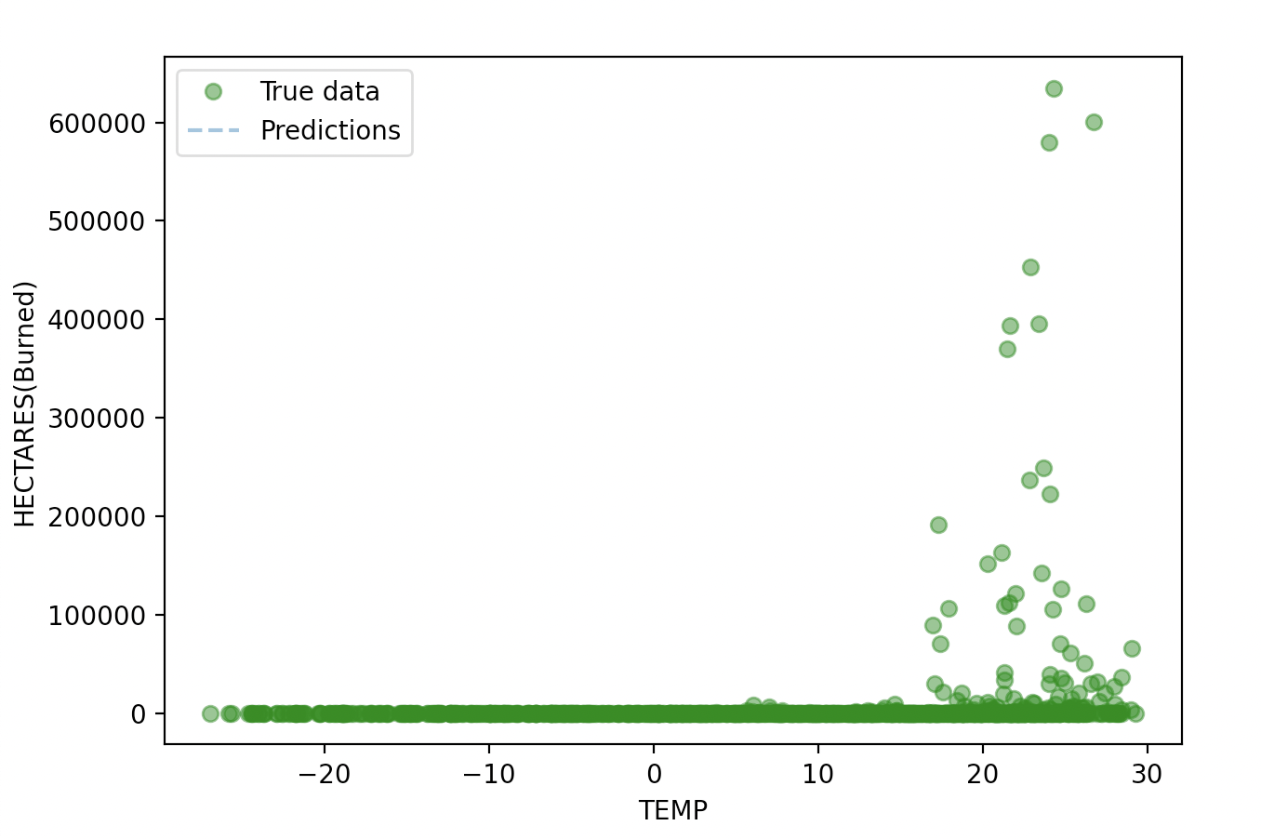
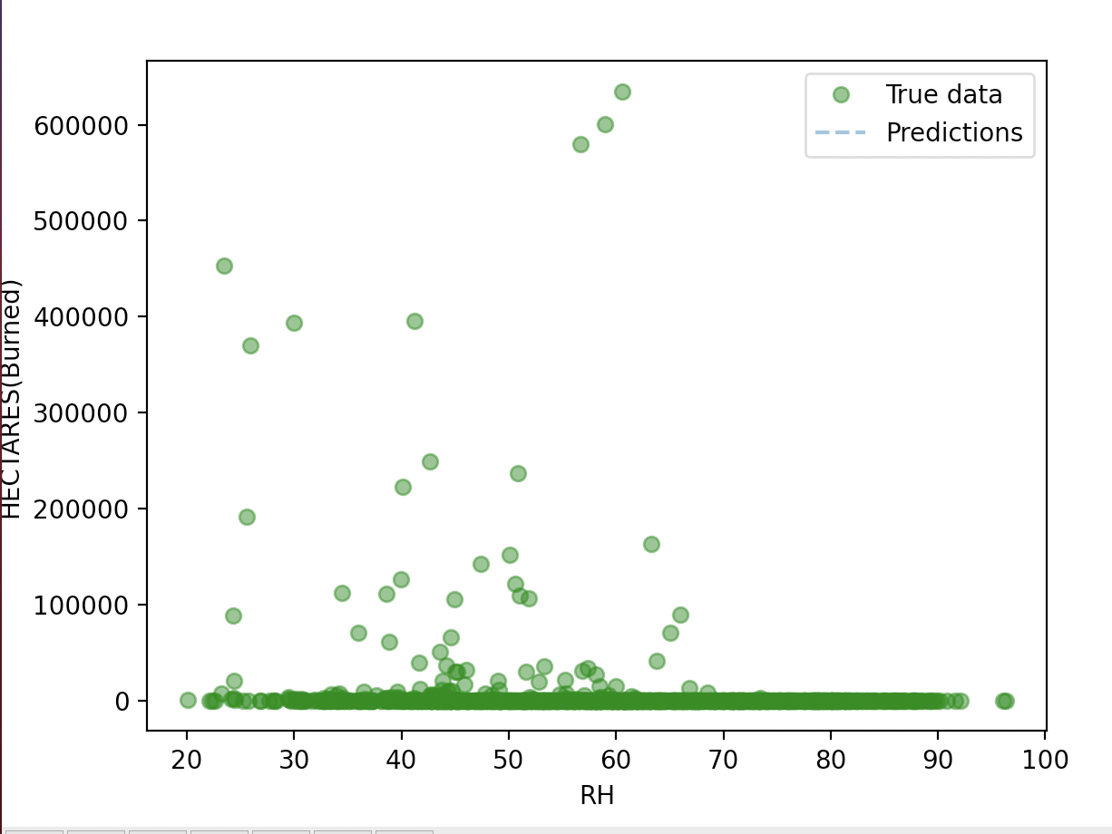
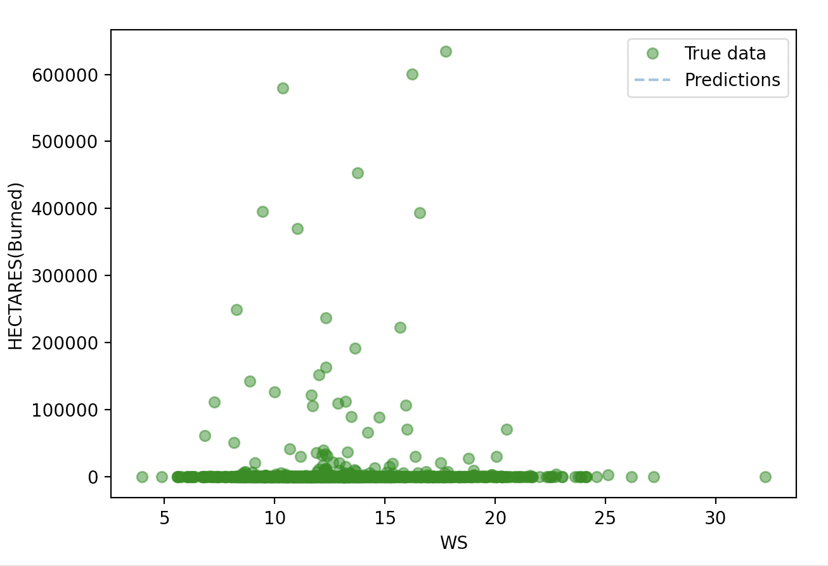
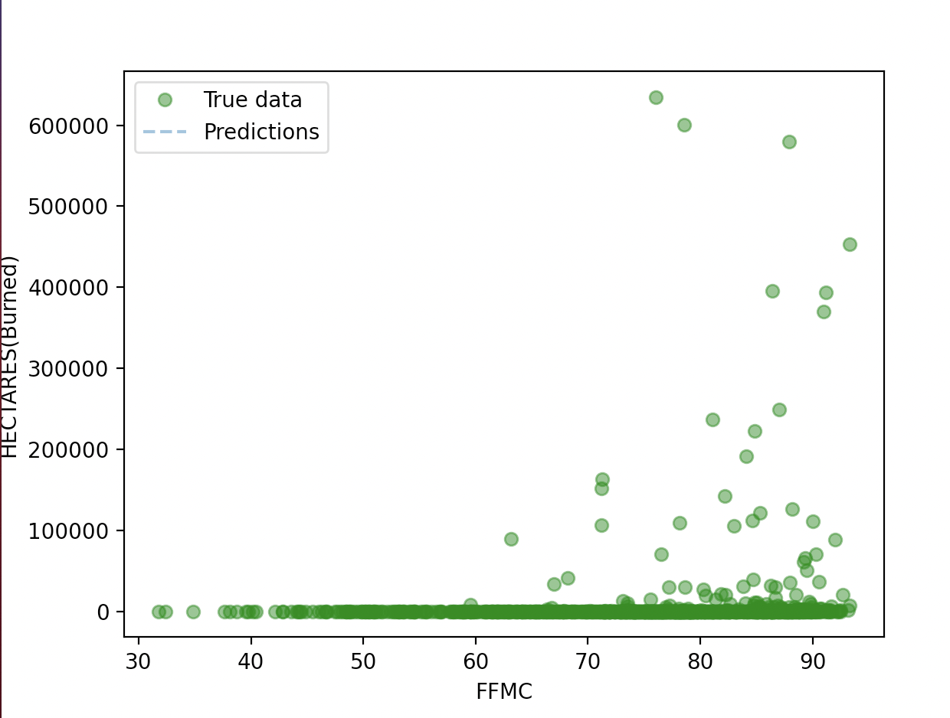
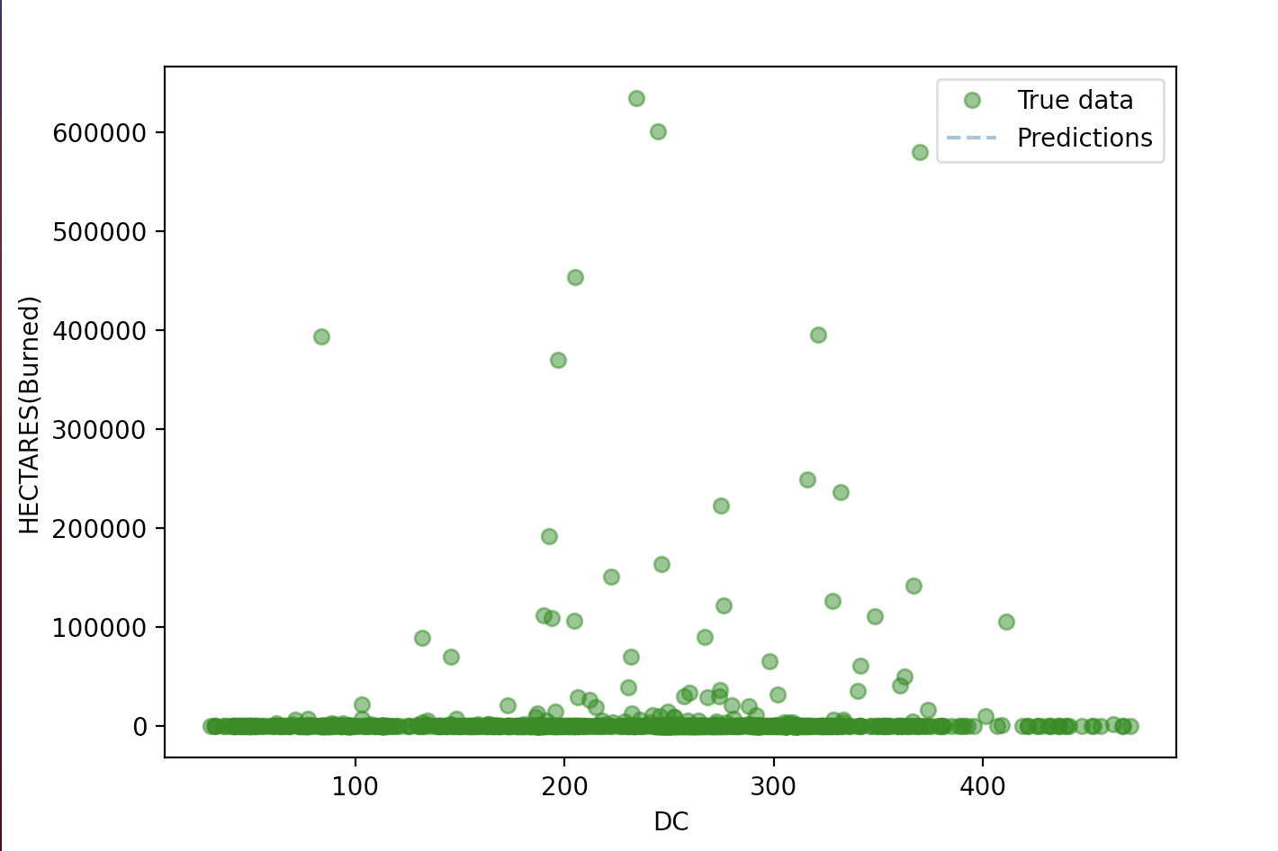
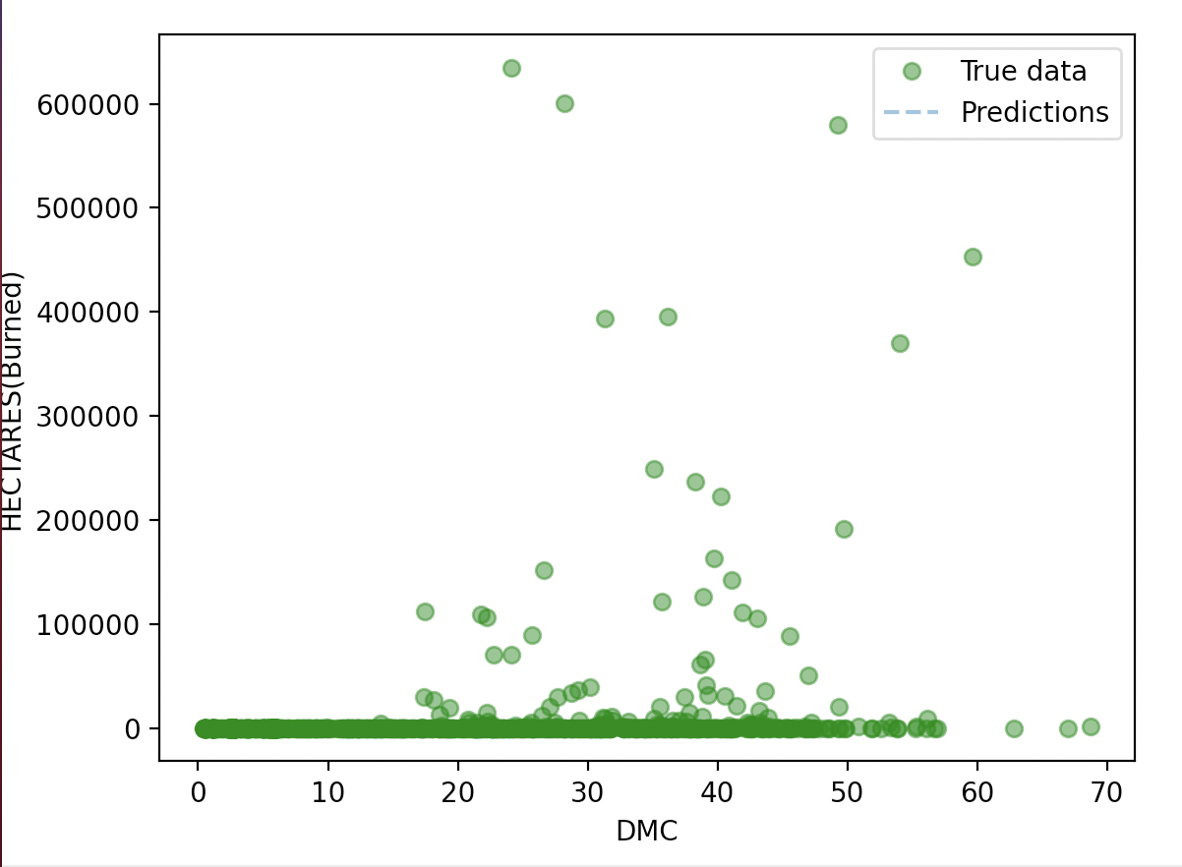

Slide 9
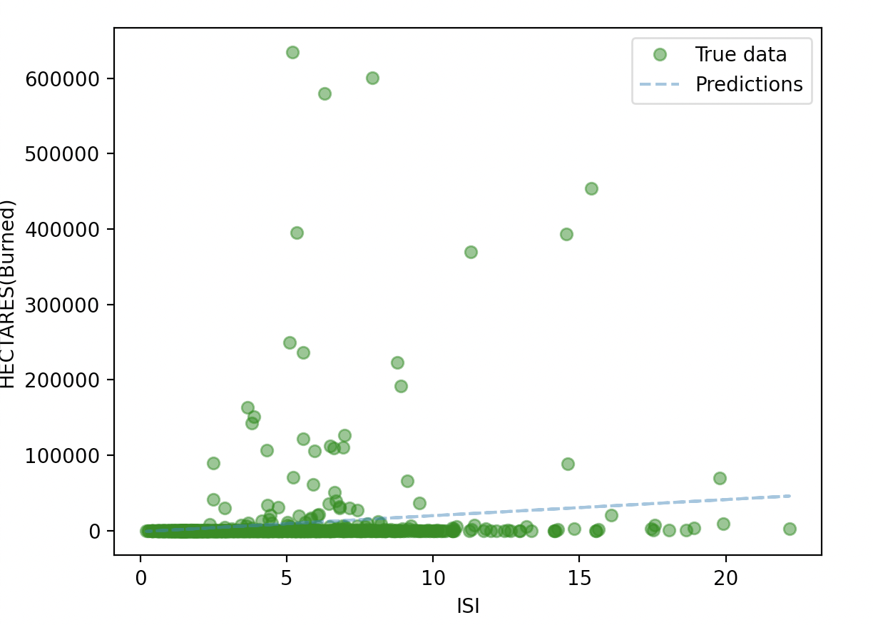
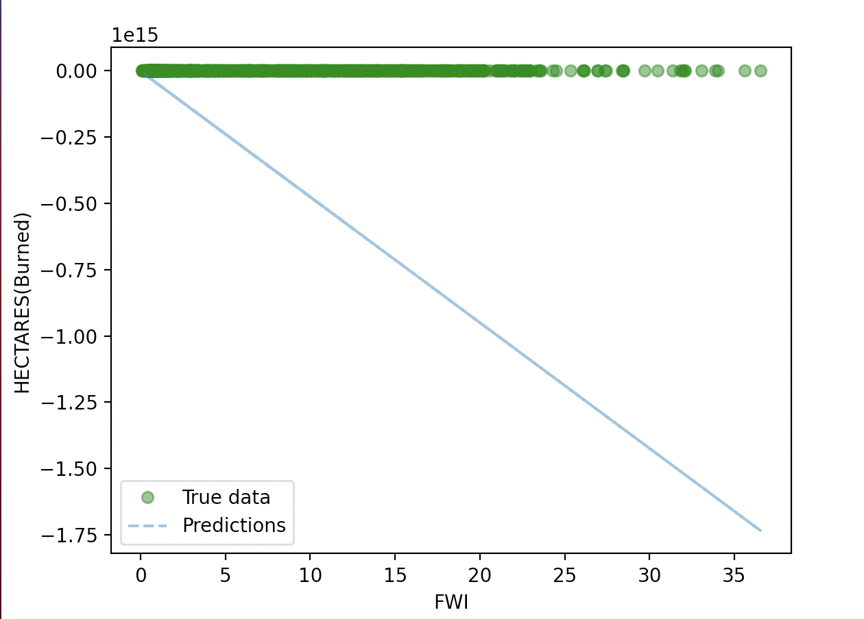
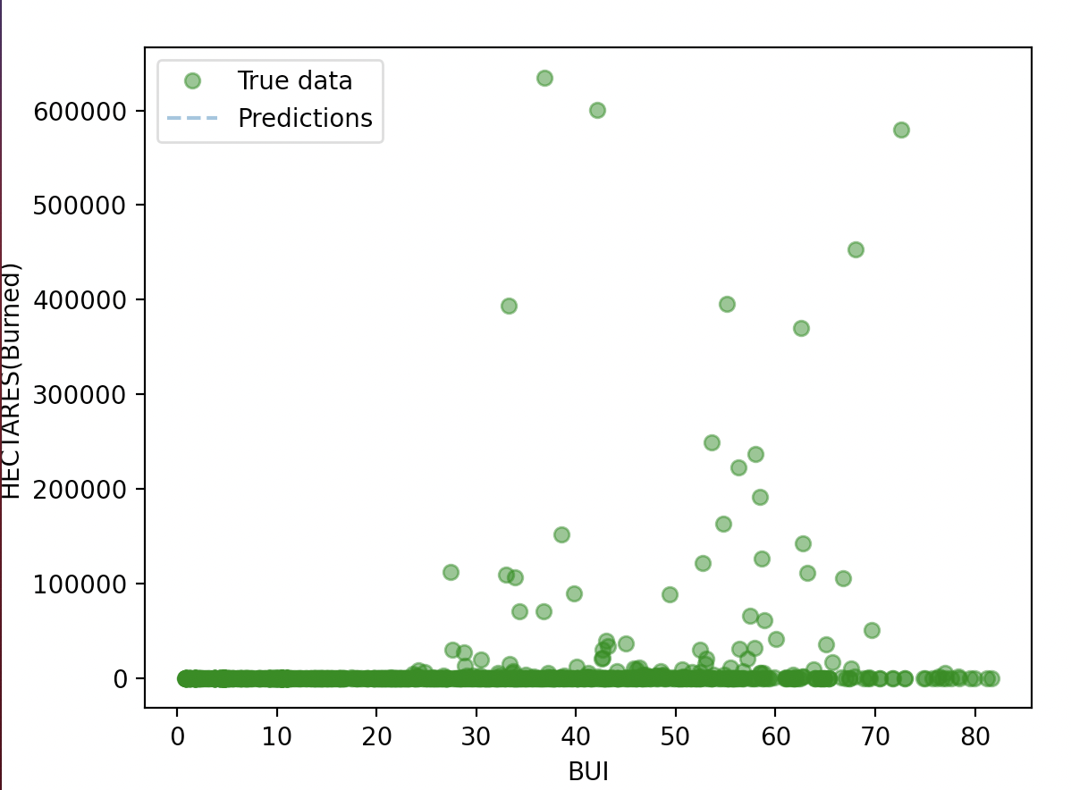
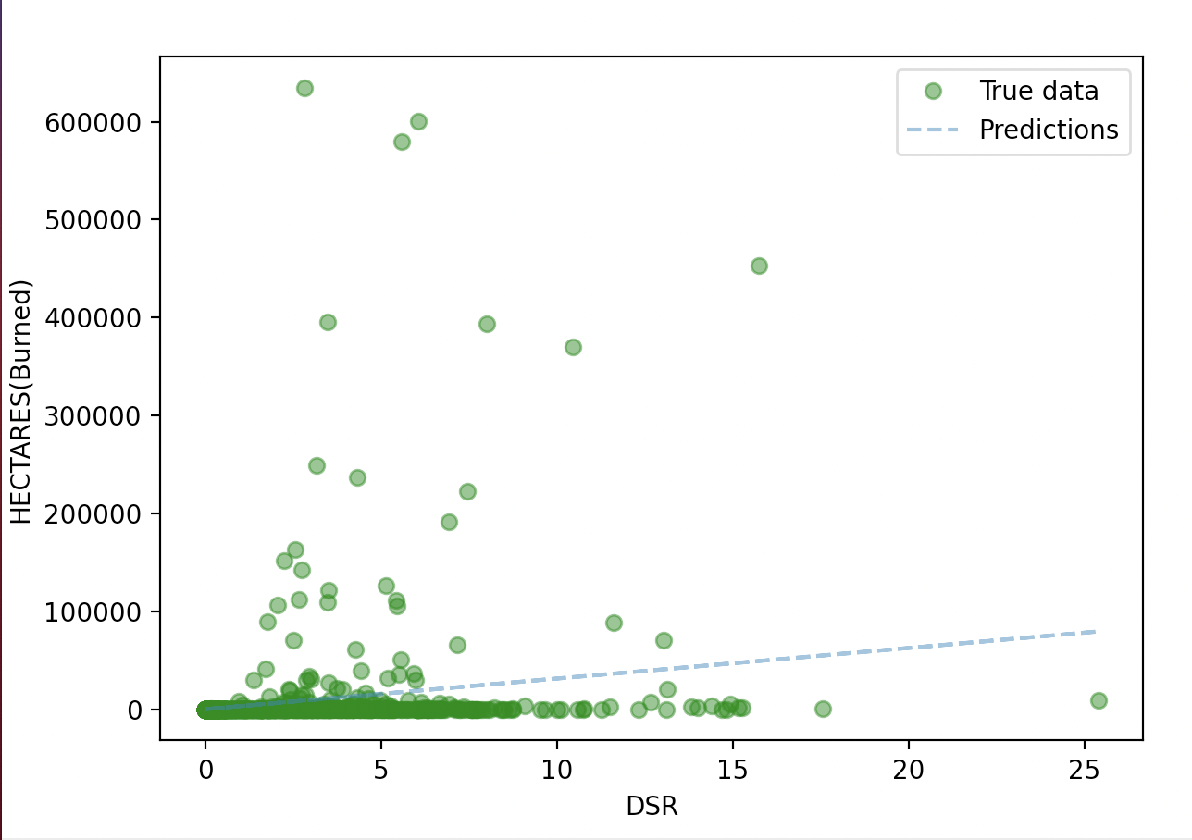
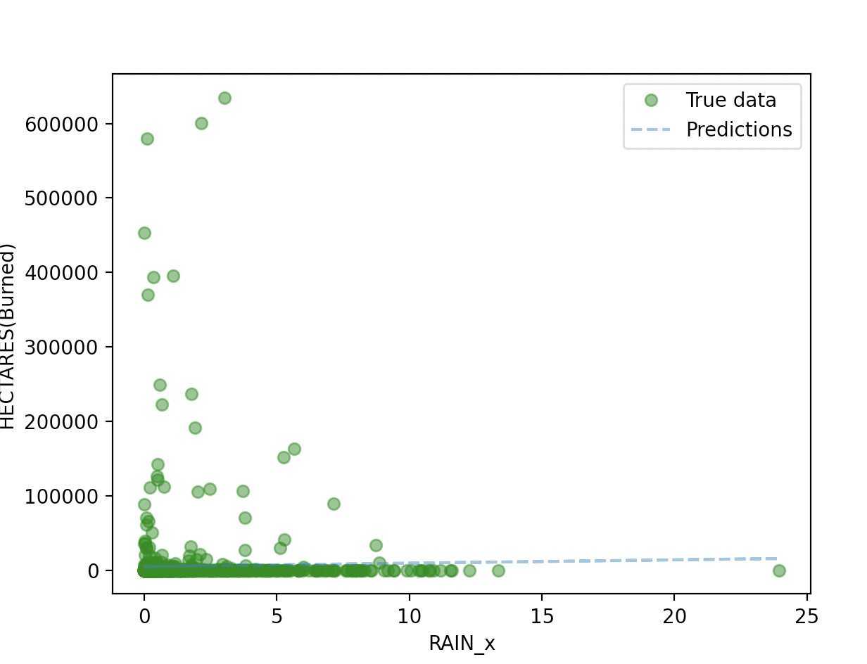
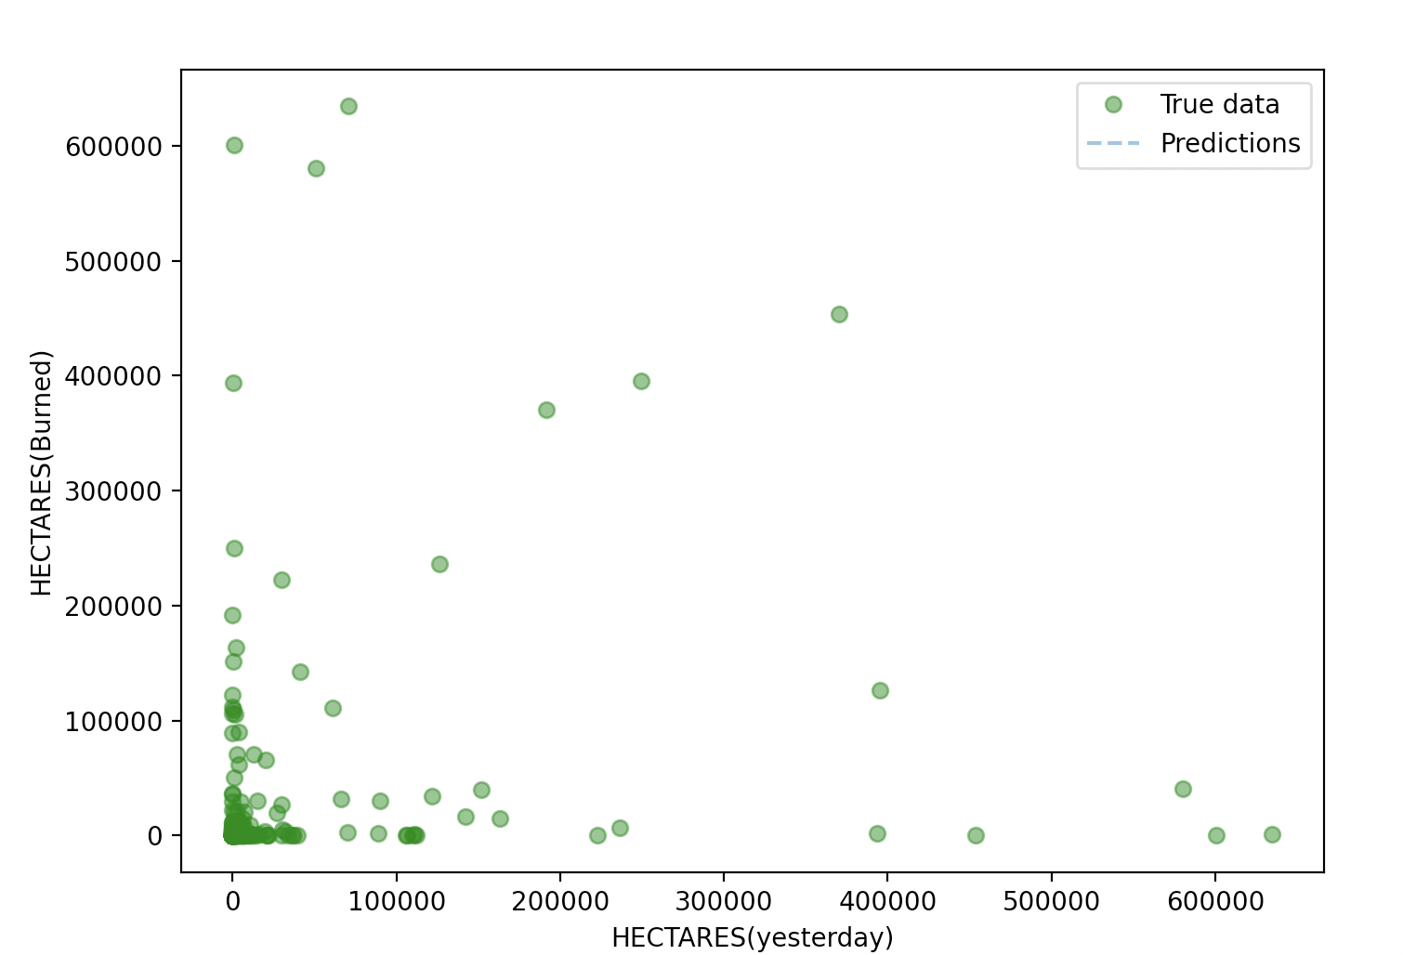

Slide 10
Project Progress
Apply mathematical model to solve practical problems
Better at Seeking help from libraries to when facing technical problem

Slide 11
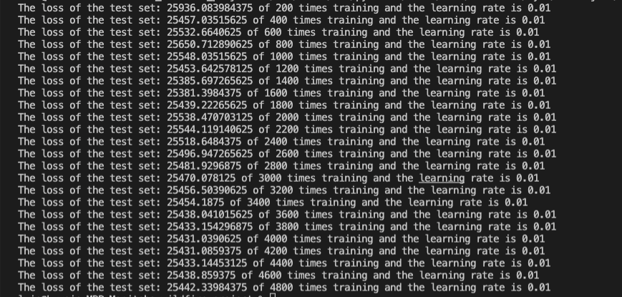
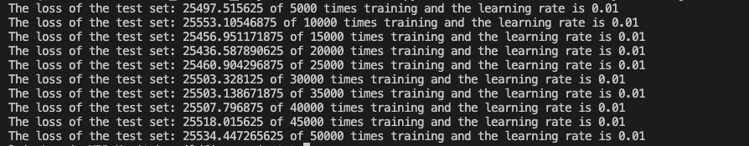

Slide 12

What We Learned
How to communicate efficiently with mentor, assigning tasks to team members
New insights into machine learning through this project

Slide 13
Summary
mentor

Slide 14
Thank you

